Slide 1

Eager execution
CS 20: TensorFlow for Deep Learning Research
Lecture 4
1/24/2017

Slide 3
Assignment 1 is out! (due 1/31)
Gitter chatroom

Slide 4
Agenda
Eager execution
Linear regression in eager
Interactive Coding!

Slide 5
Eager Execution
Presented by Akshay Agrawal
akshayka@{cs.stanford.edu, google.com}

Slide 6
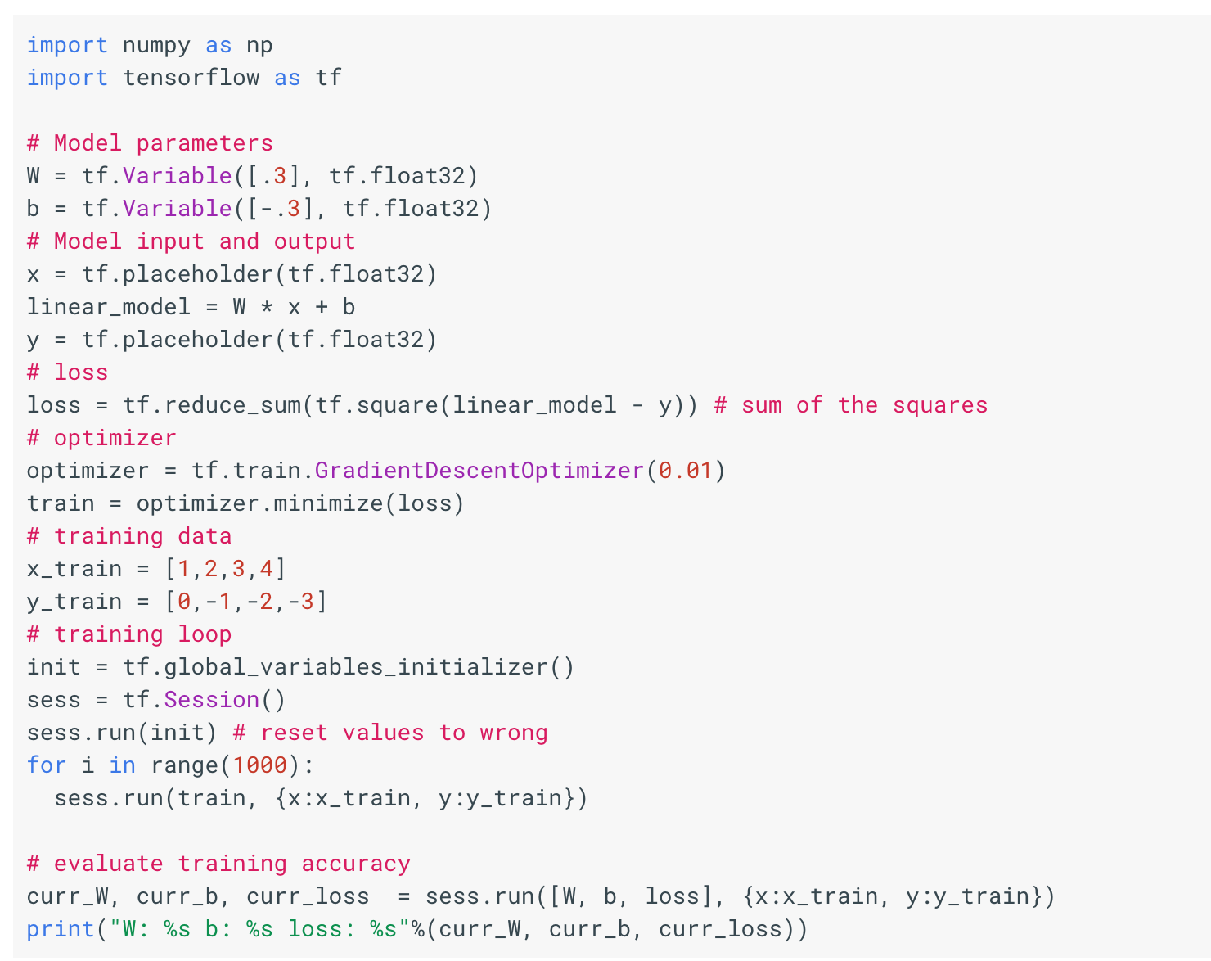
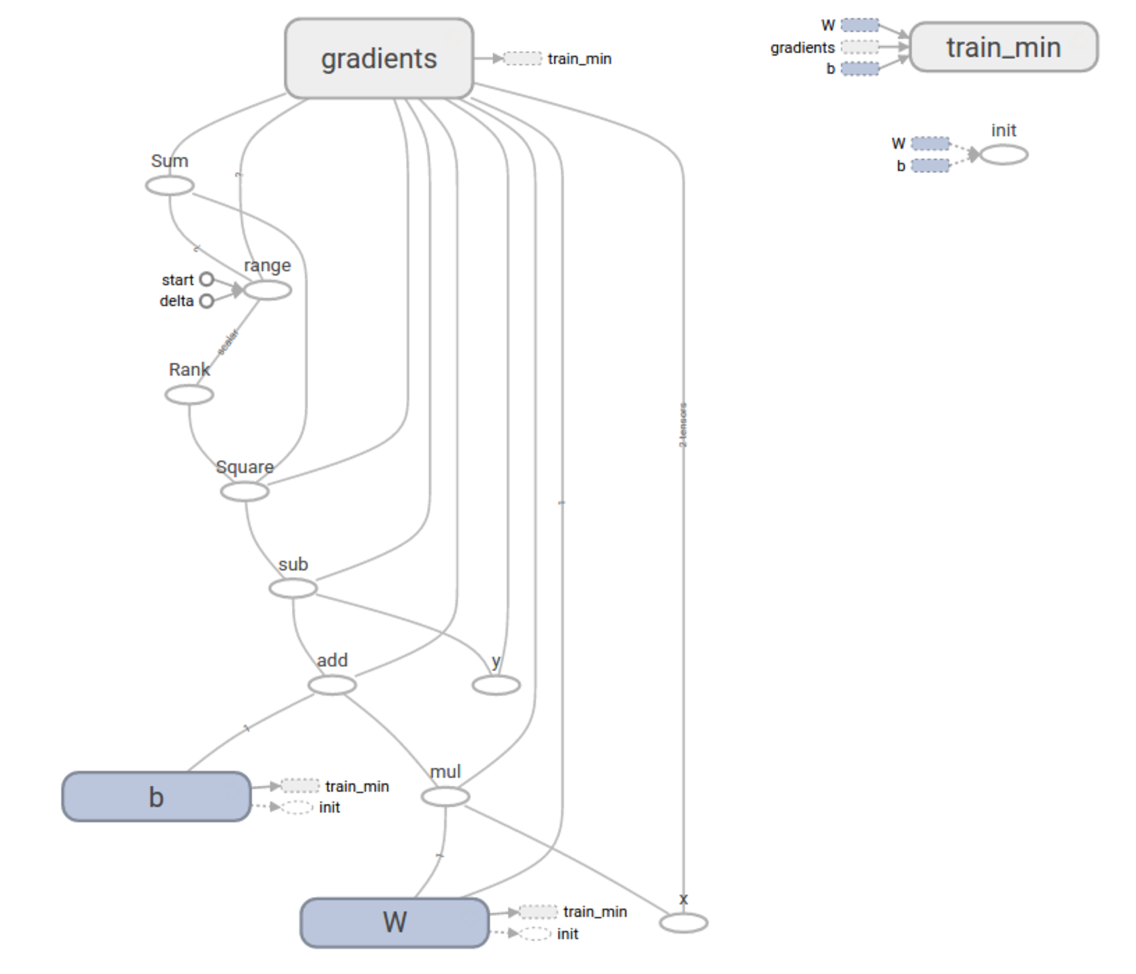
TensorFlow Today: Declarative (Graphs)
Notes:
When using TensorFlow today, you write a Python program that first constructs a graph that represents your computation; the program then invokes Session.run(), which hands the graph off for execution to the C++ runtime. In this sense, TensorFlow presents you with a declarative programming model because the specification of your computation (i.e., the creation of a Graph) is separated from the execution of it (i.e., running parts of the graph with a Session).

Slide 7
Graphs are ...
Optimizable
automatic buffer reuse
constant folding
inter-op parallelism
automatic trade-off between compute and memory
Deployable
the Graph is an intermediate representation for models
Rewritable
experiment with automatic device placement or quantization
Notes:
TensorFlow is, in some loose sense, both a programming language and a compiler for machine learning models: it takes as input a machine learning model, encoded in a low-level representation called a Graph, and then rewrites it into an optimized, executable form, applying compiler-like optimizations along the way. This paradigm has many benefits: (1) optimizations can reduce both the wall-clock time and the memory footprint of of training a model and/or running inference; (2) the Graph serves as a platform-agnostic intermediate representation that simplifies deployment; and (3) the ability to rewrite a Graph lets you experiment with policies like automatic device placement and weight quantization.

Slide 8
But graphs are also ...
Difficult to debug
errors are reported long after graph construction
execution cannot be debugged with pdb or print statements
Un-Pythonic
writing a TensorFlow program is an exercise in metaprogramming
control flow (e.g., tf.while_loop) differs from Python
can't easily mix graph construction with custom data structures
Notes:
While graphs have their (many) advantages, they also come with disadvantages. The declarative paradigm leads to programs that are difficult to debug, since errors are reported long after graphs are constructed. And because graph execution is managed by Sessions means, you can't debug your model using pdb or even print statements. Constructing a graph is kind of like coding in assembly language — you can, in principle, use graphs to implement just about any machine learning model you want; doing so, however, might be difficult. Writing a TensorFlow program is an exercise in metaprogramming: you use Python to write a program in the language of TensorFlow graphs. As a consequence, you can't use native Python control flow constructs (like `while` loops), and you instead have to rely on their TensorFlow equivalents, if they exist. Moreover, you can't easily mix graph construction with custom data structures: you might want to represent structured data using a Python class, but you can't pass classes cannot flow along the edges of graphs.

Slide 9
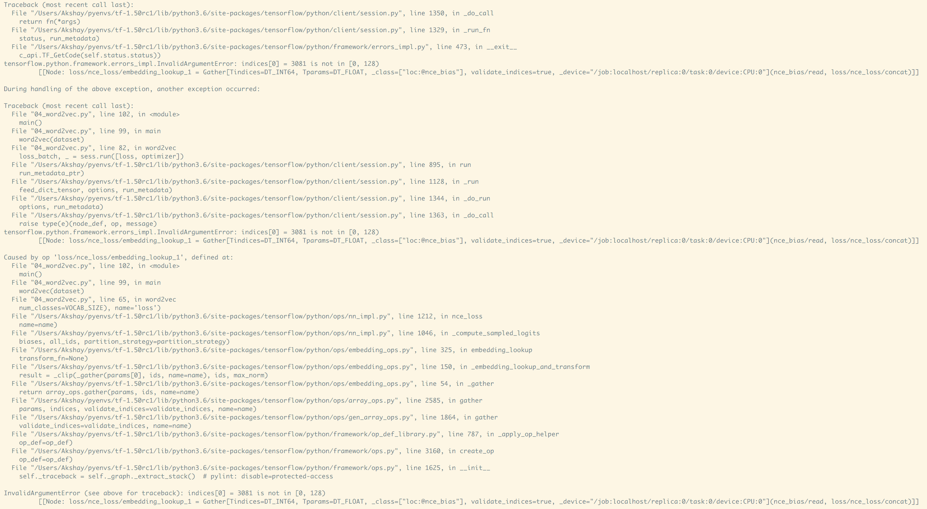
Notes:
Here's an error message that TensorFlow spat out when I accidentally used an incorrect shape when defining one of my models. If you find it difficult to parse, you're not alone (there are three tracebacks!). Debugging errors like this is a pain, because in classic TensorFlow you cannot simply step through your program with a Python debugger or a REPL; you can't even insert print statements to see what's going on!

Slide 10
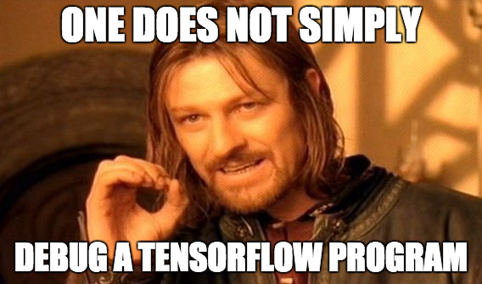
Notes:
This is how I felt when I learned TensorFlow for the first time, while I was enrolled in CS 224N last year.

Slide 11
What if...
You could execute TensorFlow operations imperatively, directly from Python?
Notes:
However, there's nothing in principle preventing us from breaking any given graph into its component ops and calling them directly from Python.

Slide 12
Eager Execution
"A NumPy-like library for numerical computation with support for GPU acceleration and automatic differentiation, and a flexible platform for machine learning research and experimentation."
the eager execution user guide

Slide 13
$python
import tensorflow # version >= 1.50
import tensorflow.contrib.eager as tfe
tfe.enable_eager_execution()
Live Demo
Notes:
The best way to understand what eager execution offers is by example. For those of you reading these slides outside of lecture, the demo is archived in examples/04_eager_repl_demo.py.

Slide 14
Key Advantages
Compatible with Python debugging tools
pdb.set_trace() to your heart's content!
Provides immediate error reporting
Permits use of Python data structures
e.g., for structured input
Enables easy, Pythonic control flow
if statements, for loops, recursion, oh my!
i = tf.constant(0)
while i < 1000:
i = tf.add(i, 1)
print("I could do this all day! %d" % i)

Slide 15
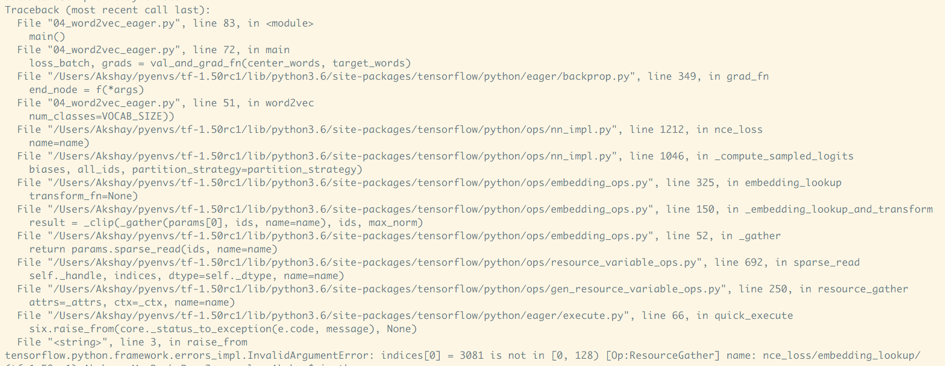

Slide 16


Slide 17
Eager execution
simplifies your code

Slide 18
You no longer need to worry about ...
placeholders
sessions
control dependencies
"lazy loading"
{name, variable, op} scopes

Slide 19
Boilerplate
x = tf.placeholder(tf.float32, shape=[1, 1]) m = tf.matmul(x, x) print(m) # Tensor("MatMul:0", shape=(1, 1), dtype=float32) with tf.Session() as sess: m_out = sess.run(m, feed_dict={x: [[2.]]}) print(m_out) # [[4.]]
Code like this...
Notes:
The first, probably most obvious, change is in reduced boilerplate.
Here’s a program to multiply a matrix with itself - where we first define a graph with a placeholder, then create a session and execute the graph in that session, feeding in the matrix to be squared.

Slide 20
Boilerplate
x = [[2.]] # No need for placeholders! m = tf.matmul(x, x) print(m) # No sessions! # tf.Tensor([[4.]], shape=(1, 1), dtype=float32)
Becomes this
Notes:
With eager execution enabled, these 3 lines provide the same effect. No sessions, no placeholders and the matmul operation provides a value immediately.

Slide 21
"Lazy Loading"
x = tf.random_uniform([2, 2]) with tf.Session() as sess: for i in range(x.shape[0]): for j in range(x.shape[1]): print(sess.run(x[i, j]))
Each iteration adds nodes to the graph
Notes:
Eager execution also helps avoids stumbling on metaprogramming.
For example, the code here is what one might quickly hack up in the middle of their program to analyze the Tensor x.
It’s easy to miss, but each iteration of the loop is adding operations to the in-memory representation of the graph
In this particular case, there is also the fact that each call to session.run is executing the random_uniform operation, so this snippet here isn’t printing a consistent snapshot of the tensor.

Slide 22
"Lazy Loading"
x = tf.random_uniform([2, 2]) for i in range(x.shape[0]): for j in range(x.shape[1]): print(x[i, j])
Notes:
With eager execution enabled, there is no notion of a graph or repeated executions of an operation, so the most obvious way to do things work out quite well.

Slide 23
Tensors Act Like NumPy Arrays
x = tf.constant([1.0, 2.0, 3.0])
# Tensors are backed by NumPy arrays
assert type(x.numpy()) == np.ndarray
squared = np.square(x) # Tensors are compatible with NumPy functions
# Tensors are iterable!
for i in x:
print(i)
for i in range(x.shape[0]): for j in range(x.shape[1]): print(x[i, j])
Caveat: use tf.equal to compare Tensors, not ==

Slide 24
Gradients

Slide 25
Gradients
Automatic differentiation is built into eager execution
Under the hood ...
Operations are recorded on a tape
The tape is played back to compute gradients
This is reverse-mode differentiation (backpropagation).
Notes:
When eager execution is enabled, the operations executed are traced in a “tape” that is played back to compute gradients. If you’re familiar with the autograd package, the API is very similar.

Slide 26
Gradients
def square(x): return x ** 2 grad = tfe.gradients_function(square) print(square(3.)) # tf.Tensor(9., shape=(), dtype=float32) print(grad(3.)) # [tf.Tensor(6., shape=(), dtype=float32))]
Differentiate w.r.t. input of square
x

Slide 27
Gradients
Use tfe.Variable when eager execution is enabled.
x
x = tfe.Variable(2.0)
def loss(y): return (y - x ** 2) ** 2 grad = tfe.implicit_gradients(loss) print(loss(7.)) # tf.Tensor(9., shape=(), dtype=float32) print(grad(7.)) # [(<tf.Tensor: -24.0, shape=(), dtype=float32>,
<tf.Variable 'Variable:0' shape=()
dtype=float32, numpy=2.0>)]
Differentiate w.r.t. variables used to compute loss
x

Slide 28
Gradients
APIs for computing gradients work even when eager execution is not enabled
tfe.gradients_function()
tfe.value_and_gradients_function()
tfe.implicit_gradients()
tfe.implicit_value_and_gradients()
See the user guide for documentation

Slide 29
Huber Regression
with Eager Execution

Slide 30
Interactive Coding
04_regression_eager_starter.py

Slide 31
It's not that different

Slide 32
A Collection of Operations
TensorFlow = Operation Kernels + Execution
Graph construction: Execute compositions of operations with Sessions
Eager execution: Execute compositions with Python
Notes:
One way to view TensorFlow is as a collection of operations - math, linear algebra, image processing, summary generation for TensorBoard visualization etc. - and a means to execute computations that compose them. Sessions provide one way to execute these compositions. With eager execution, Python is the way to execute compositions.
But the underlying operations remain the same. And as a result, a bulk of the API surface remains the same too.

Slide 33
A Collection of Operations
Majority of TF API works regardless of whether eager execution is enabled.
But, when eager execution is enabled …
prefer tfe.Variable under eager execution (compatible with graph construction)
manage your own variable storage — variable collections are not supported!
use tf.contrib.summary
use tfe.Iterator to iterate over datasets under eager execution
prefer object-oriented layers (e.g., tf.layers.Dense)
functional layers (e.g., tf.layers.dense) only work if wrapped in tfe.make_template
prefer tfe.py_func over tf.py_func
See the user guide for details and updates

Slide 34
What if I like graphs?
Graphs are ...
Optimizable
automatic buffer reuse
constant folding
inter-op parallelism
automatic trade-off between compute and memory
Deployable
the Graph is an intermediate representation for models
Rewritable
experiment with automatic device placement or quantization

Slide 35
Imperative to declarative and back
Write model definition code once
The same code can execute operations in one Python process and construct graphs in another (see user guide/examples)
Checkpoints are compatible
Train eagerly, checkpoint, load in a graph, or vice-versa
Create graphs while eager execution is enabled:
@tfe.function: "Compile" computation into graphs

Slide 36
So when should I use eager execution?

Slide 37
Use eager if you're ...
a researcher and want a flexible framework
python control flow and data structures enable experimentation
developing a new model
immediate error reporting simplifies debugging
new to TensorFlow
eager execution lets you explore the TF API in the Python REPL
Note: In TF 2.0, eager execution will be enabled by default.

Slide 38
Status
Available in version 1.5 of TensorFlow (import tf.contrib.eager as tfe)
Single GPU, ResNet benchmark performance comparable to graphs
Under active development
Overheads on smaller operations are significant
Distributed support is in the works
Not all TF APIs are eager-compatible

Slide 39
Further reading
Read the user guide to learn about …
High-level, Keras-like APIs for constructing models
tfe.Network, tf.layers.Layer
Checkpointing variables
Summaries and tensorboard
Custom gradients for numerical stability
Using GPUs
Check out the examples folder for idiomatic code

Slide 40
Links
Paper
Research blog post
README
User guide
Idiomatic model examples
Survey paper on autodiff for machine learning
Github issues page
Found a bug? Want a feature? Create an issue!
Feedback: akshayka@cs.stanford.edu

Slide 41
Next class
Variable sharing
Manage experiments
Autodiff
Feedback: huyenn@stanford.edu
Thanks!

